Slide 1
System Calls:
A system call is a way for a user program to interface with the operating system.
The program requests several services, and the OS responds by invoking a series of system calls to satisfy the request.
A system call can be written in assembly language or a high-level language like C or Pascal.
System calls are predefined functions that the operating system may directly invoke if a high-level language is used.
A system call is a method for a computer program to request a service from the kernel of the operating system on which it is running.

Slide 2
A system call is a method of interacting with the operating system via programs and it is a request from computer software to an operating system's kernel.
The Application Program Interface (API) connects the operating system's functions to user programs.
It acts as a link between the operating system and a process, allowing user-level programs to request operating system services.
The kernel system can only be accessed using system calls. System calls are required for any programs that use resources.

Slide 3
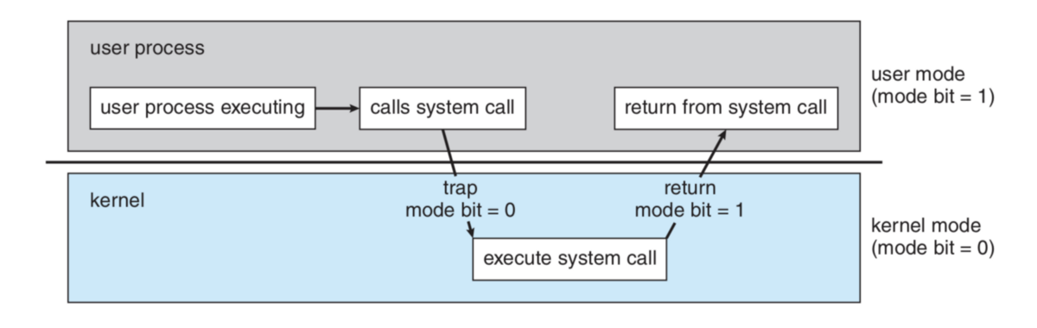
Fig. Calling System Call

Slide 4
How are system calls made?
When a computer software needs to access the operating system's kernel, it makes a system call.
The system call uses an API to expose the operating system's services to user programs.
It is the only method to access the kernel system.
All programs or processes that require resources for execution must use system calls, as they serve as an interface between the operating system and user programs.
Below are some examples of how a system call varies from a user function.

Slide 5
A system call function may create and use kernel processes to execute the asynchronous processing.
A system call has greater authority than a standard subroutine.
A system call with kernel-mode privilege executes in the kernel protection domain.
System calls are not permitted to use shared libraries or any symbols that are not present in the kernel protection domain.
The code and data for system calls are stored in global kernel memory.

Slide 6
Why do you need system calls in Operating System?
There are various situations where you must require system calls in the operating system. Following of the situations are as follows:
It is must require when a file system wants to create or delete a file.
Network connections require the system calls to sending and receiving data packets.
If you want to read or write a file, you need to system calls.
If you want to access hardware devices, including a printer, scanner, you need a system call.
System calls are used to create and manage new processes.

Slide 7
How System Calls Work
The Applications run in an area of memory known as user space.
A system call connects to the operating system's kernel, which executes in kernel space.
When an application creates a system call, it must first obtain permission from the kernel.
It achieves this using an interrupt request, which pauses the current process and transfers control to the kernel.
If the request is permitted, the kernel performs the requested action, like creating or deleting a file.
As input, the application receives the kernel's output.
The application resumes the procedure after the input is received.
When the operation is finished, the kernel returns the results to the application and then moves data from kernel space to user space in memory.

Slide 8
A simple system call may take few nanoseconds to provide the result, like retrieving the system date and time.
A more complicated system call, such as connecting to a network device, may take a few seconds.
Most operating systems launch a distinct kernel thread for each system call to avoid bottlenecks.
Modern operating systems are multi-threaded, which means they can handle various system calls at the same time.

Slide 9
Types of System Calls
There are commonly five types of system calls. These are as follows:
Process Control
File Management
Device Management
Information Maintenance
Communication
Protection

Slide 10
Process Control
Process control is the system call that is used to direct the processes.
Some process control examples include creating, load, abort, end, execute, process, terminate the process, etc.
A running program needs to be able to halt its execution either normally (end()) or abnormally (abort()).
If a system call is made to terminate the currently running program abnormally, or if the program runs into a problem and causes an error trap, a dump of memory is sometimes taken and an error message generated.
The dump is written to a special log file on disk and may be examined by a debugger—a system program designed to aid the programmer in finding and correcting errors, or bugs— to determine the cause of the problem.

Slide 11
Process control
◦ create process, terminate process
◦ load, execute
◦ get process attributes, set process attributes
◦ wait event, signal event
◦ allocate and free memory
abort

Slide 12
File Management
File management is a system call that is used to handle the files. Some file management examples include creating files, delete files, open, close, read, write, etc.
We first need to be able to create() and delete() files. Either system call requires the name of the file and perhaps some of the file’s attributes.
Once the file is created, we need to open() it and to use it. We may also read(), write(), or reposition() (rewind or skip to the end of the file, for example).
Finally, we need to close() the file, indicating that we are no longer using it.
File attributes include the file name, file type, protection codes, accounting information, and so on.
At least two system calls, get file attributes() and set file attributes(), are required for this function.
Some operating systems provide many more calls, such as calls for file move() and copy().

Slide 13
File management
◦ create file, delete file
◦ open, close
◦ read, write, reposition
◦ get file attributes, set file attributes

Slide 14
Device management
A process may need several resources to execute—main memory, disk drives, access to files, and so on.
If the resources are available, they can be granted, and control can be returned to the user process.
Otherwise, the process will have to wait until sufficient resources are available
The various resources controlled by the operating system can be thought of as devices.
Some of these devices are physical devices (for example, disk drives), while others can be thought of as abstract or virtual devices (for example, files).
A system with multiple users may require us to first request() a device, to ensure exclusive use of it.
After we are finished with the device, we release() it.
These functions are similar to the open() and close() system calls for files.

Slide 15
Device management
◦ request device, release device
◦ read, write, reposition
◦ get device attributes, set device attributes
◦ logically attach or detach devices

Slide 16
Information Maintenance
Information maintenance is a system call that is used to maintain information.
There are some examples of information maintenance, including getting system data, set time or date, get time or date, set system data, etc.
Many system calls exist simply for the purpose of transferring information between the user program and the operating system.
For example, most systems have a system call to return the current time() and date().
Other system calls may return information about the system, such as the version number of the operating system, the amount of free memory or disk space, and so on.
Another set of system calls is helpful in debugging a program. Many systems provide system calls to dump() memory. This provision is useful for debugging.

Slide 17
The program strace, which is available on Linux systems, lists each system call as it is executed.
Even microprocessors provide a CPU mode, known as single step, in which a trap is executed by the CPU after every instruction.
The trap is usually caught by a debugger.
Information maintenance
◦ get time or date, set time or date
◦ get system data, set system data
◦ get process, file, or device attributes
◦ set process, file, or device attributes

Slide 18
Communication
There are two common models of inter-process communication: the message passing model and the shared-memory model.
In the message-passing model, the communicating processes exchange messages with one another to transfer information.
Messages can be exchanged between the processes either directly or indirectly through a common mailbox.
Before communication can take place, a connection must be opened.
The name of the other communicator must be known, be it another process on the same system or a process on another computer connected by a communications network.
Each computer in a network has a host name by which it is commonly known.

Slide 19
A host also has a network identifier, such as an IP address.
Similarly, each process has a process name, and this name is translated into an identifier by which the operating system can refer to the process.
The get hostid() and get processid() system calls do this translation.
The identifiers are then passed to the general purpose open() and close() calls provided by the file system or to specific open connection() and close connection() system calls, depending on the system’s model of communication.
Communications
◦ create, delete communication connection
◦ send, receive messages
◦ transfer status information
◦ attach or detach remote devices

Slide 20
Protection
Protection provides a mechanism for controlling access to the resources provided by a computer system.
Historically, protection was a concern only on multi-programmed computer systems with several users.
However, with the advent of networking and the Internet, all computer systems, from servers to mobile handheld devices, must be concerned with protection.
Typically, system calls providing protection include set permission() and get permission(), which manipulate the permission settings of resources such as files and disks.
The allow user() and deny user() system calls specify whether particular users can—or cannot—be allowed access to certain resources.

Slide 21
Protection
◦ get file permissions
◦ set file permissions

Slide 22
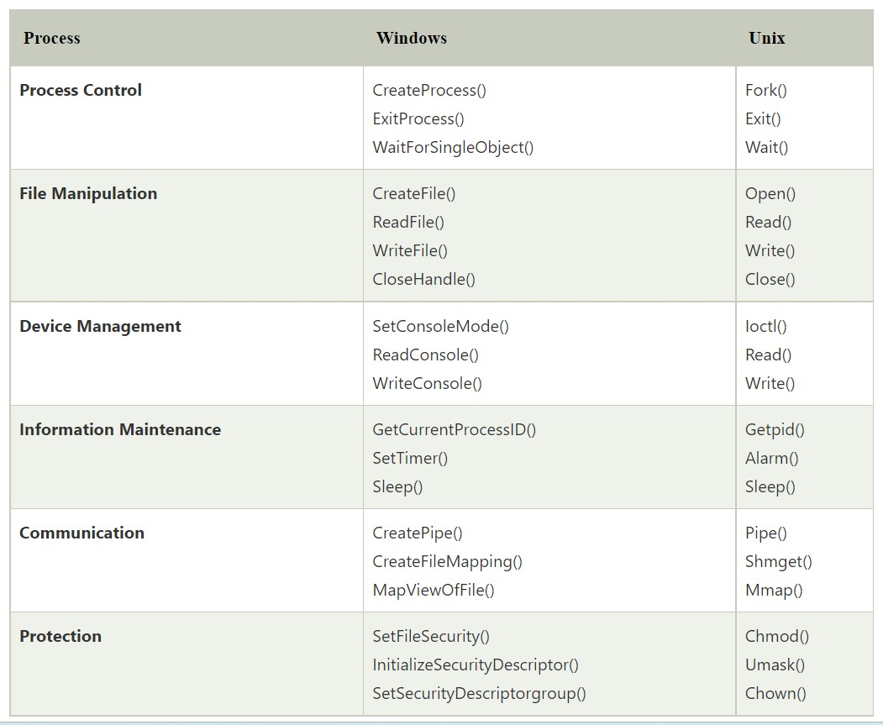

Slide 23
open()
The open() system call allows you to access a file on a file system. It allocates resources to the file and provides a handle that the process may refer to. Many processes can open a file at once or by a single process only. It's all based on the file system and structure.
read()
It is used to obtain data from a file on the file system. It accepts three arguments in general:
A file descriptor.
A buffer to store read data.
The number of bytes to read from the file.
The file descriptor of the file to be read could be used to identify it and open it using open() before reading.

Slide 24
wait()
In some systems, a process may have to wait for another process to complete its execution before proceeding.
When a parent process makes a child process, the parent process execution is suspended until the child process is finished.
The wait() system call is used to suspend the parent process.
Once the child process has completed its execution, control is returned to the parent process.
write()
It is used to write data from a user buffer to a device like a file.
This system call is one way for a program to generate data.
It takes three arguments in general:
A file descriptor.
A pointer to the buffer in which data is saved.
The number of bytes to be written from the buffer.

Slide 25
fork()
Processes generate clones of themselves using the fork() system call.
It is one of the most common ways to create processes in operating systems.
When a parent process spawns a child process, execution of the parent process is interrupted until the child process completes.
Once the child process has completed its execution, control is returned to the parent process.
close()
It is used to end file system access.
When this system call is invoked, it signifies that the program no longer requires the file, and the buffers are flushed, the file information is altered, and the file resources are de-allocated as a result.

Slide 26
exec()
When an executable file replaces an earlier executable file in an already executing process, this system function is invoked.
As a new process is not built, the old process identification stays, but the new process replaces data, stack, data, head, etc.
exit()
The exit() is a system call that is used to end program execution.
This call indicates that the thread execution is complete, which is especially useful in multi-threaded environments.
The operating system reclaims resources spent by the process following the use of the exit() system function.

Slide 27
System calls in short
Process Control
It is responsible for file manipulation jobs, including creating files, deleting files, reading, opening, writing, closing, etc.
File Management
It is responsible for file manipulation jobs, including creating files, opening files, deleting files, closing files, etc.
Device Management
These are responsible for device manipulation, including reading from device buffers, writing into device buffers, etc.
Information Maintenance
These are used to manage the data and its share between the OS and the user program. Some common instances of information maintenance are getting time or date, getting system data, setting time or date, setting system data, etc.
Communication
These are used for inter process communication (IPC). Some examples of IPC are creating, sending, receiving messages, deleting communication connections, etc.

